Slide 1
Auto-ID Data collection made simple ! Ottap Applications Data Collection System OADCS Commonsense Solutions for Complex Problems! from
Ottap Application Solutions, LLC
Richmond, VA, USA
www.ottapapplications.com

Slide 2
OADCS Auto-ID Data collection made simple !
Plan With Confidence !
Build With Ease !
&
Deploy Without Pain !

Slide 3
OADCS Auto-ID Data collection made simple !
OADCS is a tool which could enable you to extend its usability to any application area you can think of.
Traditionally users have seen data collection system being used primarily in Supply Chain Applications such as Warehousing, Shipping or shop-floor applications.
With the future looking to be owned by mobile applications, this tool will help you to position yourself well in advance to take on business challenges of tomorrow

Slide 4
OADCS Auto-ID Data collection made simple !
OADCS is a tool that could enable a business analyst to easily configure and translate a business requirement to a working data collection system to suite that specific business requirement.
The Data Collection solution thus built will have a flexible architecture to easily interface with any back-end business systems such as legacy applications, ERP systems running on any of the popular platforms such as Windows, Unix, Linux, (AS/400) iseries or Mainframe systems.
It can run on databases such as MYSQL, MS SQL Server, Oracle 8i +, DB2, PostgreSQL and any other database which can interact with a JDBC interface.

Slide 5
OADCS Auto-ID Data collection made simple !
Create Transactions
Create Rules
Attach Rules to Transactions
Create Roles
Create Users
Attach Users to Roles
Attach Roles to Transactions

Slide 6
OADCS Auto-ID Data collection made simple !
Rules can be shared by multiple transactions
Roles can be shared by multiple users
Roles can share multiple transactions

Slide 7
OADCS Auto-ID Data collection made simple !
Rules can be built by SQLs, Stored Procedure calls or external program calls
Screen prompts of transactions can be built by non-programmers!
Simple UI with no complications !
The same data collection front-end can be used for any back-end Enterprise Application Software !
Data collection can be made available even when the back-end Enterprise Application System is not available for posting due to backups or planned or unplanned outage !

Slide 8
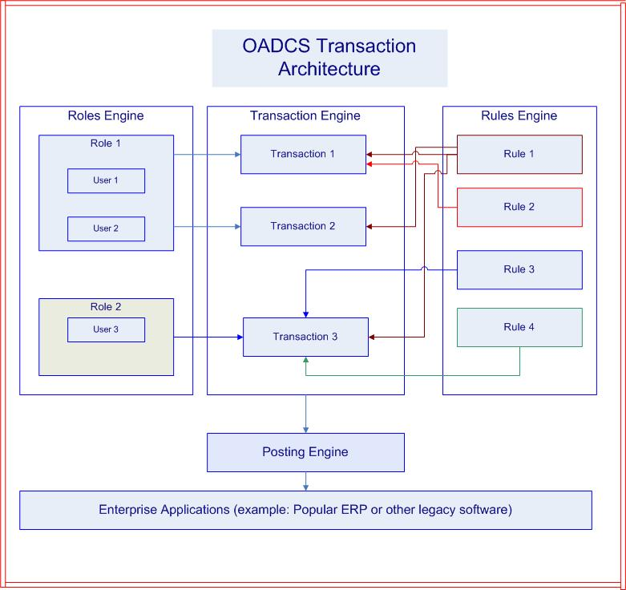
OADCS Auto-ID Data collection made simple !

Slide 9
OADCS Auto-ID Data collection made simple !
Minimum Investment
Flexible Architecture
Ease of Use

Slide 10
OADCS Auto-ID Data collection made simple !
The material in this document is confidential and owned by Ottap Application Solutions, LLC, Richmond, VA, USA and is protected by international copy right laws. Unauthorized use or reproduction of the material in this document in any form is prohibited. You are not permitted to copy, store (in any medium), transmit, show in public, adapt or change in any way the content of this document for any other purpose whatsoever without the prior written permission of the Ottap Applications Solutions,LLC.

